Slide 1
pParse User Guide
Version 2.0.0
pFind Group
2017.12
Notes:
首页标明版本号

Slide 2
Contents
Before software installation
Software registration and installation
Software usage

Slide 3
Before software installation
Please install 64-bit MSFileReader first
Windows 7 and above
64 bit version
.NET Framework 4.5 environment

Slide 4
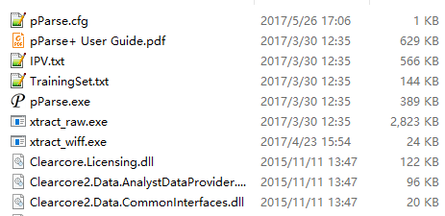
Software registration and installation
Send the registration information to pparse@ict.ac.cn, and you’ll get a software download link.
pParse doesn’t need to install. You can use it directly after decompressing “pParseStandAlone_X64.zip” into a folder.
The contents of the folder pParseStandAlone_X64 are as follows:

Slide 5
Software usage
Two usable methods
Usage 1:
Run pParse with parameter file
pParse.exe pParse.para
Usage 2:
Run pParse with command line parameters
pParse.exe -D D:\data\1.raw

Slide 6
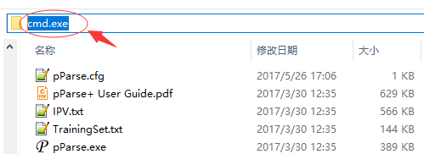
Software usage 1
Step 1
Double click “pParse.exe” to generate a parameter file.
Step 2
Run “cmd.exe” in the folder where pParse was installed.

Slide 7
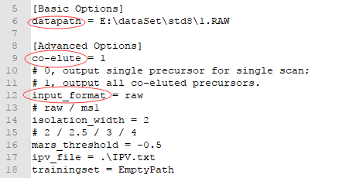
Software usage 1
Step 3
Configure parameter file.
Set the parameter “datapath”, “co-elute” and “input_format”.
Keep other parameters default.

Slide 8
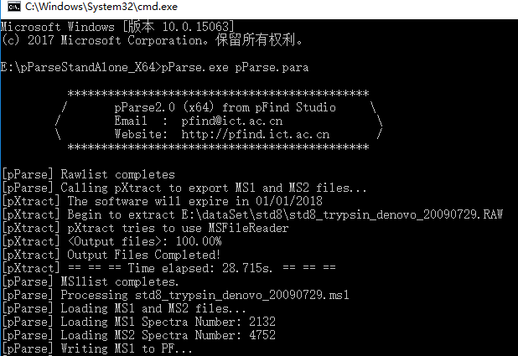
Software usage 1
Step 4
Run command “pParse.exe pParse.para”.

Slide 9
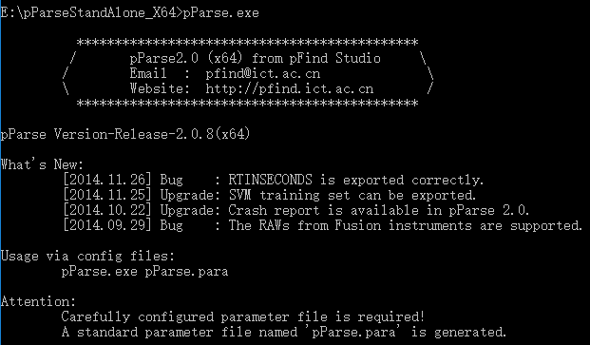
Software usage 2
Step 1
Run “pParse.exe” to get usable command line parameters.

Slide 10
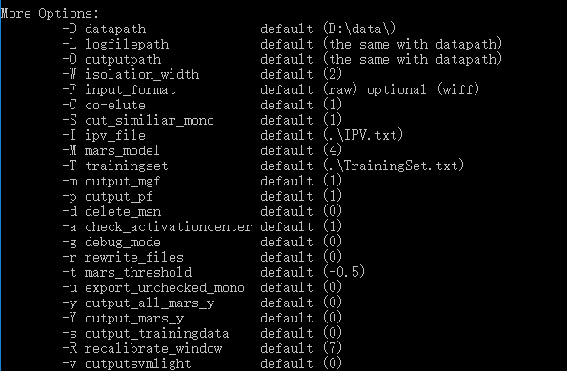
Software usage 2
Step 1
Run “pParse.exe” to get usable command line parameters.

Slide 11
Software usage 2
Step 2
Use following command to run pParse
pParse.exe -D D:\data\1.raw
Or
pParse.exe -D D:\data\1.raw –O E:\data

Slide 12
Thank you for using pParse!
If you have any questions, please contact pparse@ict.ac.cn.

